Slide 1


Slide 2
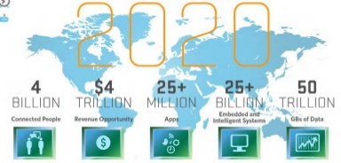

Slide 3
Web 1.0 Info – Centric Web
The first generation of the World Wide Web (WWW), characterized by separate static websites.
It is one-way broadcasting.
It is invented 1989 by Tim Berners- Lee.
It was widely used between 1998 and 2001, and it is still used beside Web 2.0 in almost all web sites.

Slide 4
Web 2.0 People Centric Web
Technologies and Trends
Social networking sites:
Facebook, MySpace, Hi5, … etc.
Tagging or Labeling Content:
Del.icio.us.
Wikis:
Wikipedia.
Community-generated content:
eBay.
Open Services:
Google.
P2P:
Bit Torrent.
New Web technologies:
XML, RSS, Ajax.
Open Source Software

Slide 5
Web 3.0 Machine Centric Web
Different meanings are intended to describe the evolution of Web usage and interaction between the many possible evolutionary paths.
The third generation of Web technologies and services that emphasize a machine-facilitated understanding of information on the Web.

Slide 6
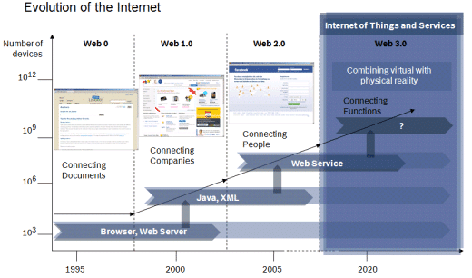

Slide 7
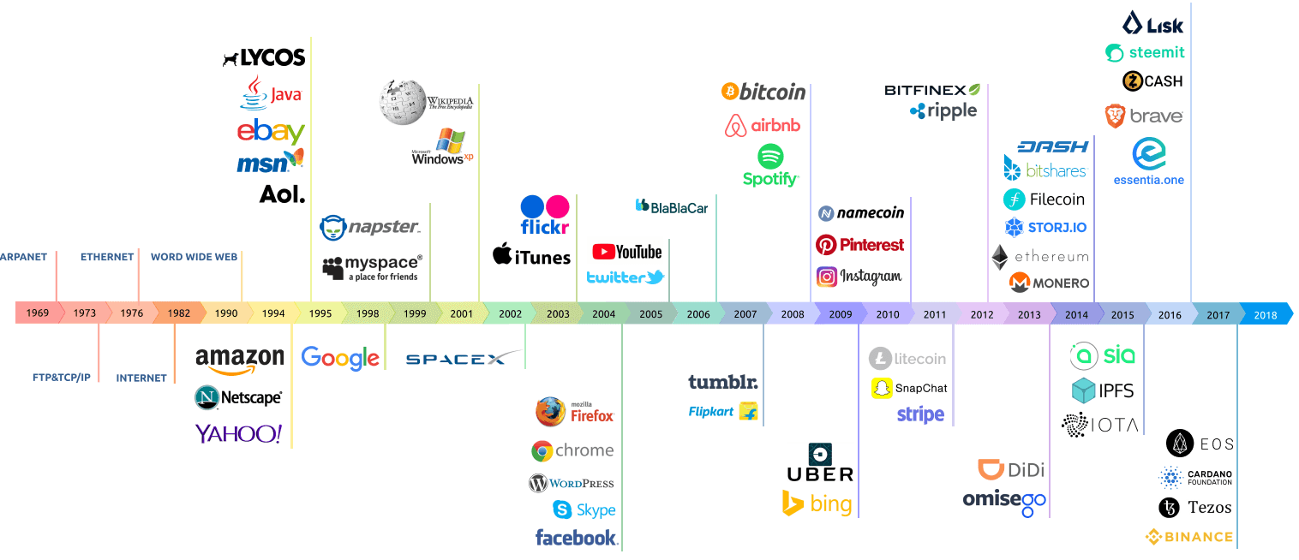

Slide 8
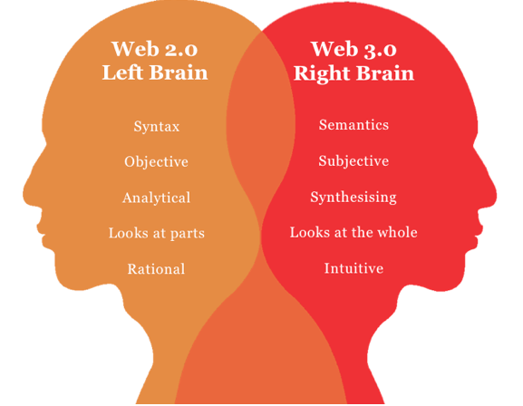

Slide 9
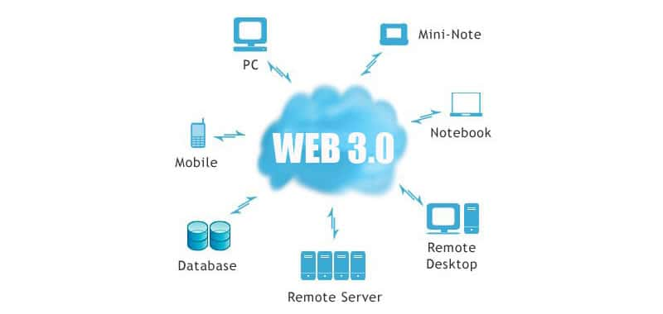

Slide 11
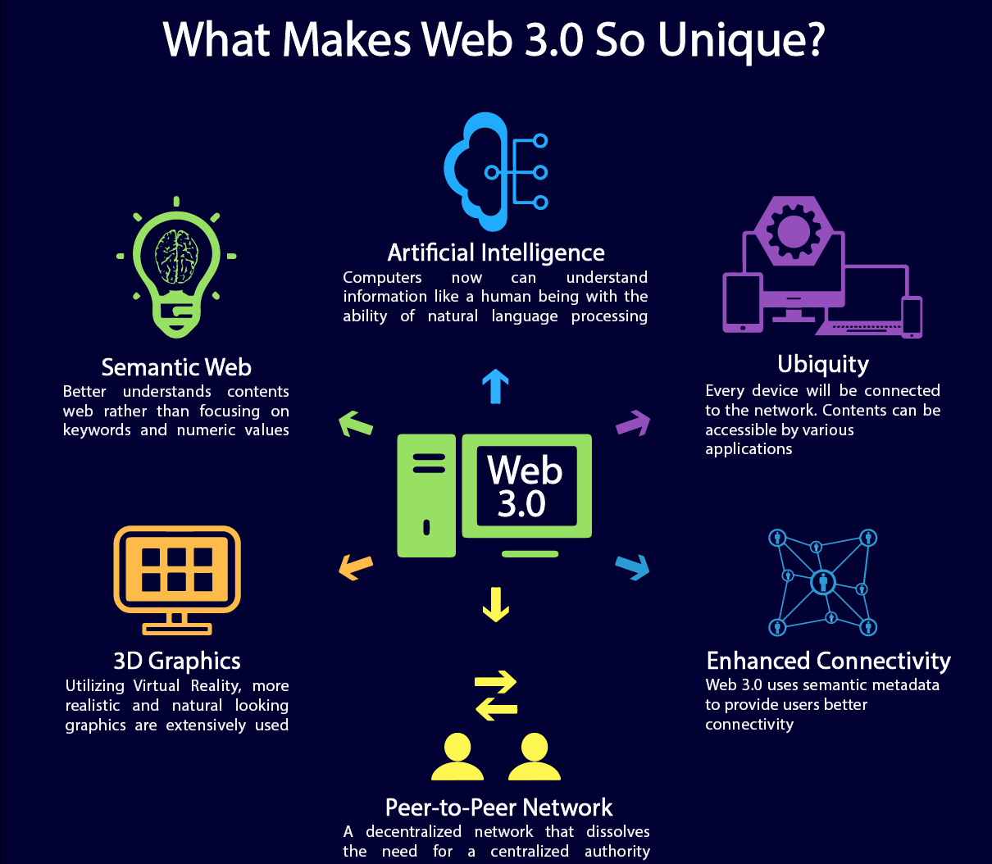

Slide 12
The 5 main features that can help us define Web 3.0
Semantic Web The next evolution of the Web involves the Semantic Web. The semantic web improves web technologies in order to generate, share and connect content through search and analysis based on the ability to understand the
Artificial Intelligence Combining this capability with natural language processing, in Web 3.0, computers can understand information like humans in order to provide faster and more relevant results. They become more intelligent to satisfy the needs of users. meaning of words, rather than on keywords or numbers.

Slide 13
3) 3D Graphics The three dimensional design is being used extensively in websites and services in Web 3.0. Museum guides, computer games, ecommerce, geospatial contexts, etc. are all examples that use 3D graphics.
4) Connectivity With Web 3.0, information is more connected thanks to semantic metadata. As a result, the user experience evolves to another level of connectivity that leverages all the available information.
5) Ubiquity Content is accessible by multiple applications, every device is connected to the web, the services can be used everywhere.

Slide 14
Web 3.0 Semantic Web
It is a group of methods and technologies to allow machines to understand the meaning - or "semantics" - of information on the World Wide Web.
The semantic web is a vision of information that is understandable by computers, so computers can perform more of the tedious work involved in finding, combining, and acting upon information on the web.

Slide 15
Semantic Web The Technology
It involves publishing in languages specifically designed for data: Resource Description Framework (RDF), Web Ontology Language (OWL), and Extensible Markup Language (XML):
HTML describes documents and the links between them.
RDF, OWL, and XML, by contrast, can describe arbitrary things such as people, meetings, or airplane parts.

Slide 16
Semantic Web Intelligent
The development of Web 3.0 focuses on adding metadata or information to describe the content of the web which:
Provide an intelligent level to the web site.
Enable the user to communicate completely with the machines.
Enable machines to communicate with each others.

Slide 17
Semantic Web Intelligent System Planning
Example:
The Question: ”I’m looking for a warm place to vacation and I have a budget of $3000. and I have an 11-year-old child.”
Today’s System, such query can lead to hours of sifting (through lists of flights, hotel, car rentals) and the options are often at odds with one another.
Web 3.0 will call up a complete vacation package that was planned as meticulously as if it had been assembled by a human travel agent.

Slide 18
Semantic Web Business and Network Applications
Web 3.0 is the ability for customers to communicate with companies.
Directly, using blogs and other Web 2.0 applications,
Indirectly, as if we were holders of psychographic data analyzed by the semantic web and other marketing tools as Micro targeting / Silent Marketing.

Slide 19
Semantic Web Semantic Meaning
Having a semantic meaning on the web, evolution will lead to have more intelligent and specialized webs.
All next evolution paths in this paper depend on having information about the web components.

Slide 20
We can say that Semantic web is the main and starting point of Web 3.0 evolution.

Slide 21
Web 3.0 Web 3D
Web 3.0 will be 3D-Internet!
Web 3.0 will be nothing else than three-dimensional internet.
At list very moment thousands of users worldwide linger in 3D-worlds like second Life or 3D-Games such as Entropiauniverse and Active worlds.
Philip Rosedale, founder of Second Life, believes that one day 1500 million people will have a second existence.
The adding of the third dimension will shift the internet into a hyper-realistic parallel world .
http://www.internet3d.org

Slide 22
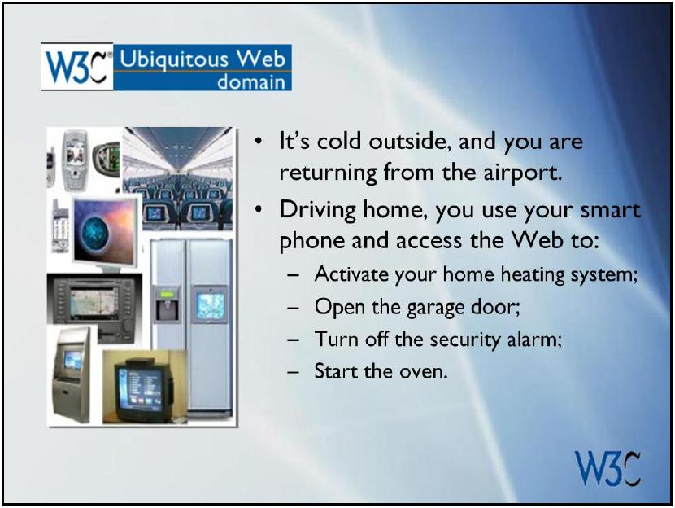
Web 3.0 Ubiquitous and pervasive web
“Our Vision of Web 3.0 is to link data and devices in new ways to achieve new insights, greater efficiencies, economic benefits and improved quality of life”
Steve Bratt.
“The Web 3.0 will see applications that are pieced together, fast, customizable, run on any device, and most importantly, disseminate virally–through social networks”
Eric Schmidt, CEO of Google

Slide 23
Web 3.0 might be defined as a third-generation of the Web enabled by the convergence of several key emerging technology trends:
Ubiquitous Connectivity
Broadband adoption
Mobile Internet access
Mobile devices
Network Computing
Software-as-a-service business models
Web services interoperability
Distributed computing (P2P, grid computing, hosted “cloud computing” server farms such as Amazon S3)

Slide 24
Open Technologies
Open APIs and protocols
Open data formats
Open-source software platforms
Open data (Creative Commons, Open Data License, etc.)
Open Identity
Open identity (OpenID)
Open reputation
Portable identity and personal data (for example, the ability to port your user account and search history from one service to another)

Slide 25
The Intelligent Web
Semantic Web technologies (RDF, OWL, SWRL, SPARQL, Semantic application platforms, and statement-based datastores such as triplestores, tuplestores and associative databases)
Distributed databases — or what I call “The World Wide Database” (wide-area distributed database interoperability enabled by Semantic Web technologies)
Intelligent applications (natural language processing, machine learning, machine reasoning, autonomous agents)

Slide 26
Conclusion
Web 3.0 is more connected, open, and intelligent, with semantic Web technologies, distributed databases, natural language processing, machine learning, machine reasoning, and autonomous agents.

Slide 27
Decentralized Architecture – Crypto – Blockchain
One of the biggest flaws of the Web 2.0 and Web 1.0 is the client-server based architecture.

Slide 28
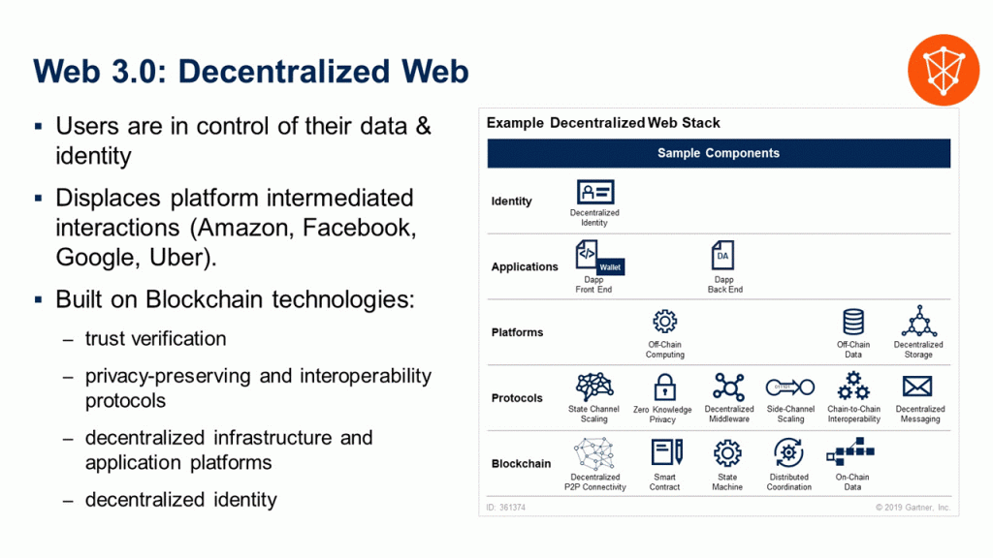

Slide 29
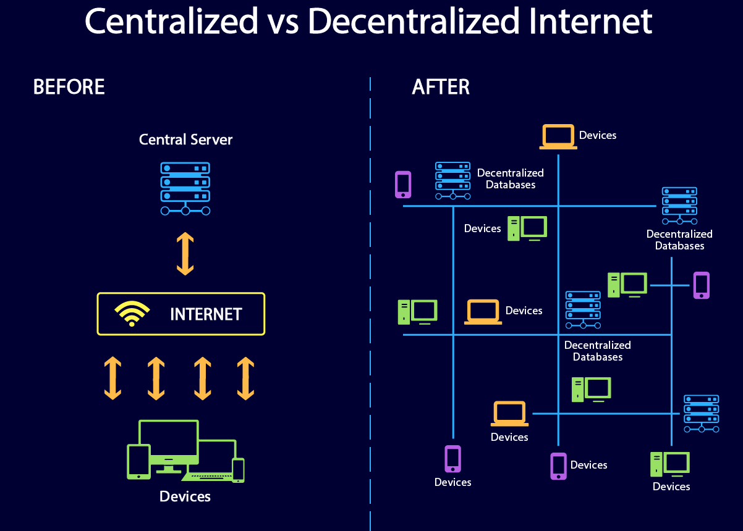

Slide 30
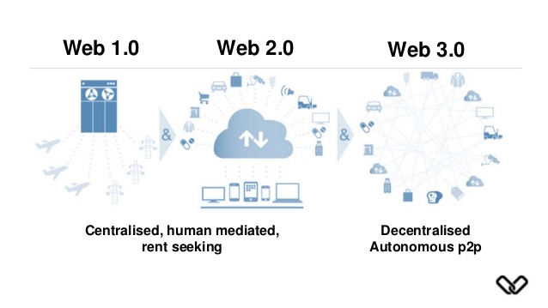

Slide 31
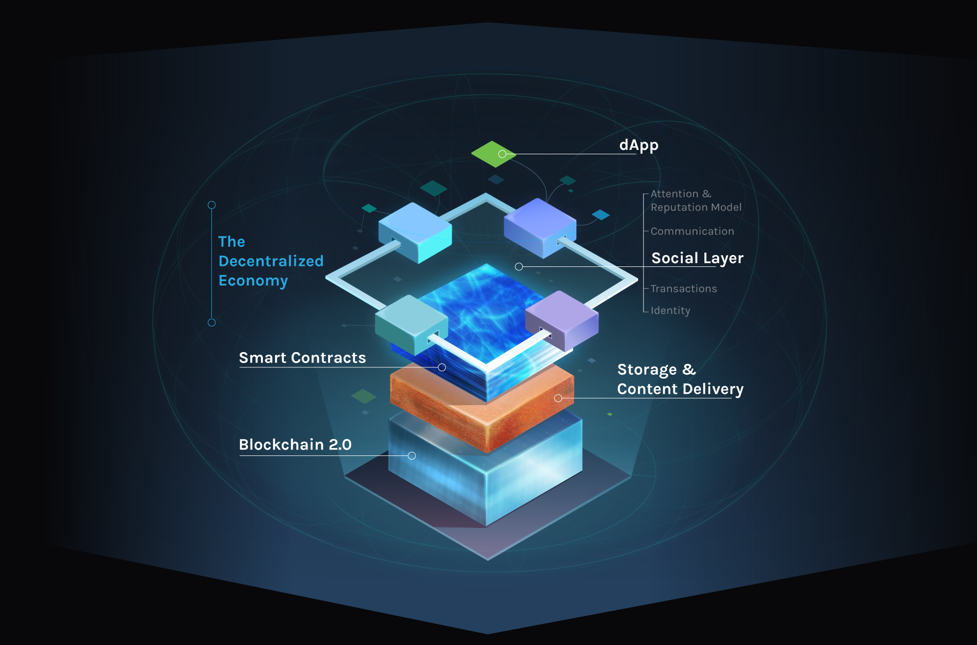
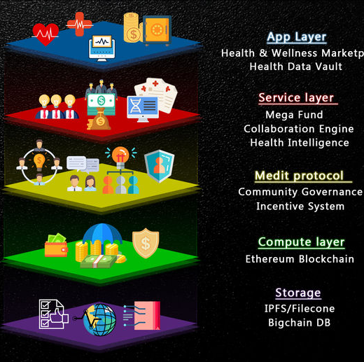

Slide 32
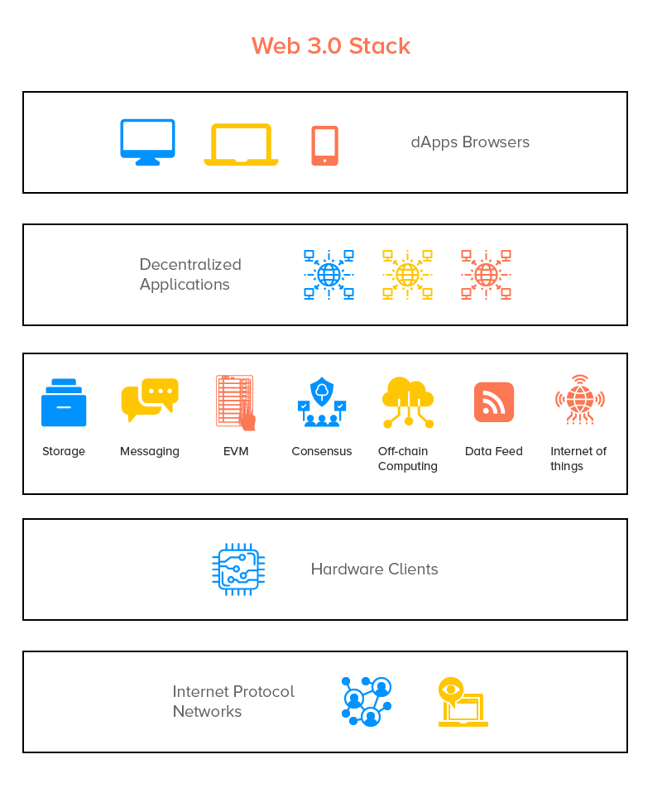

Slide 33
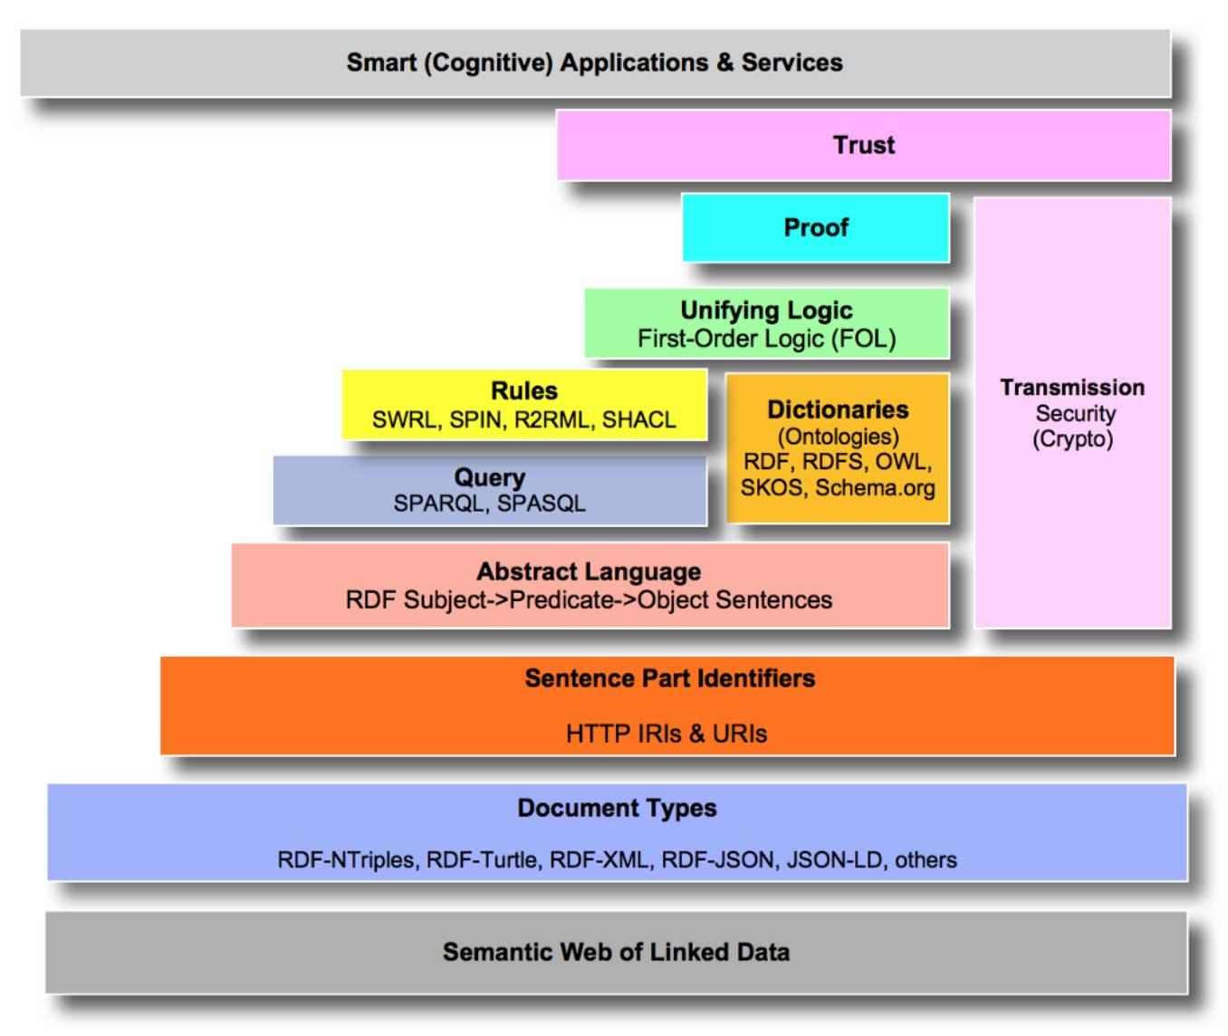
How the Arrival of Web 3.0 is Transforming Traditional Business

Slide 34
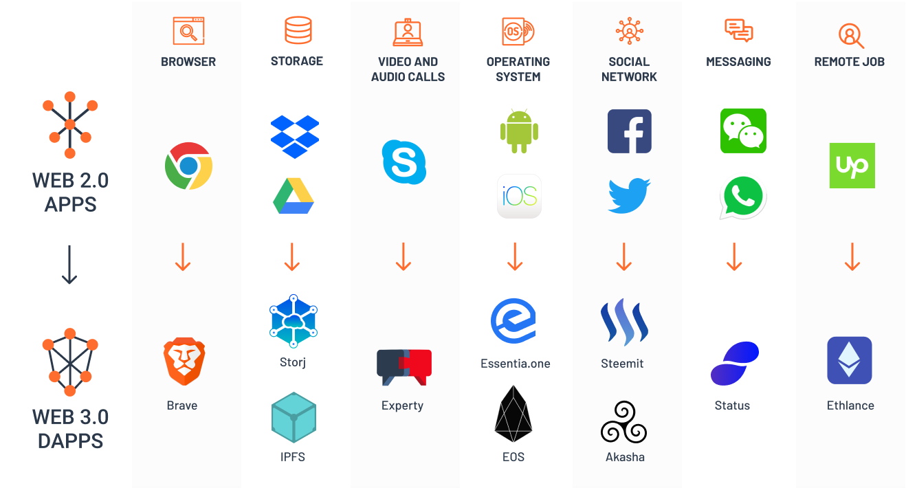

Slide 35
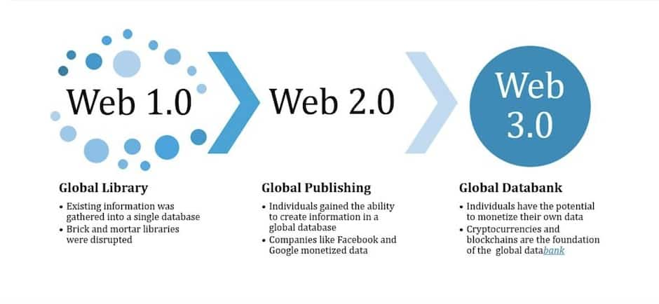

Slide 36
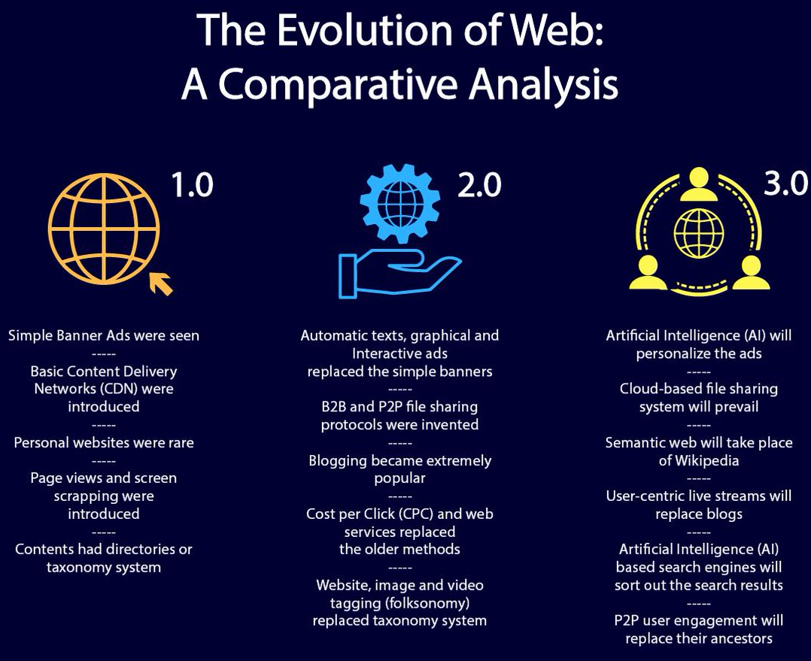

Slide 37
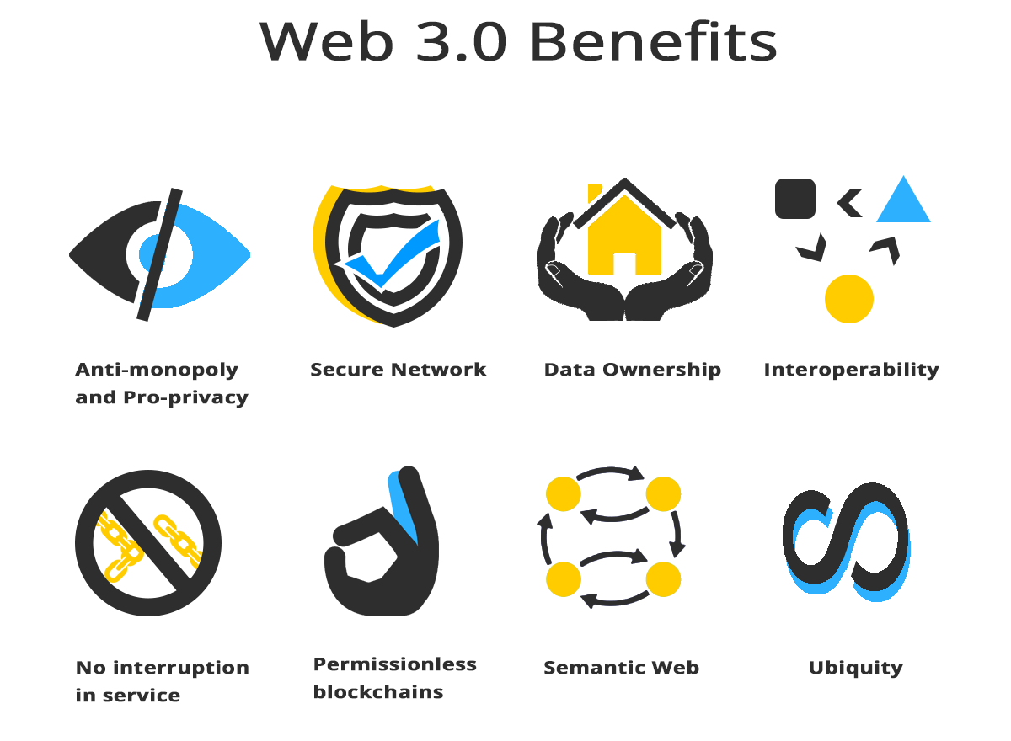

Slide 38
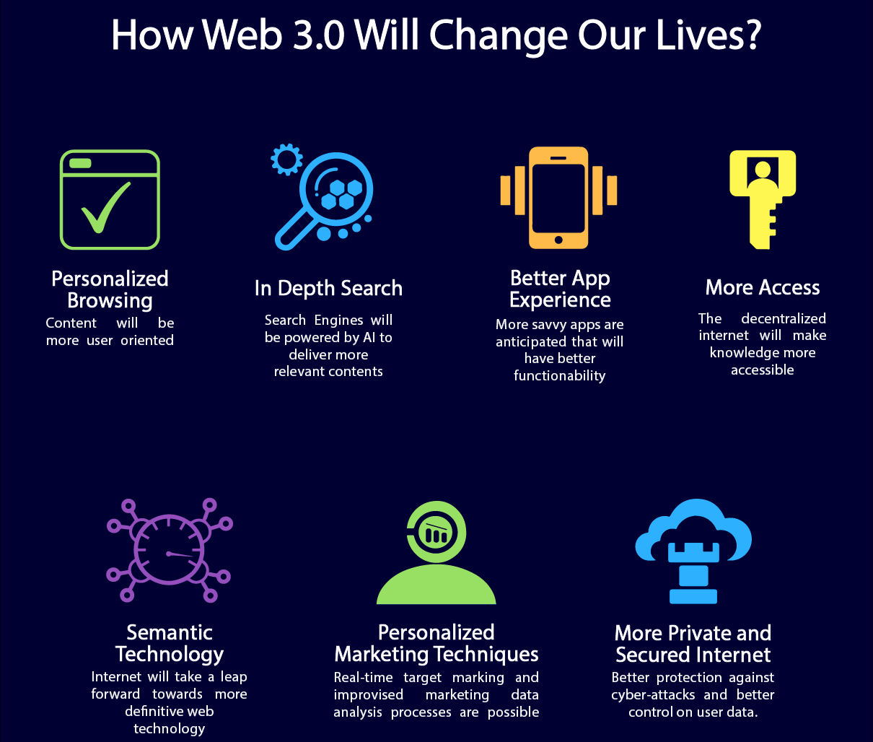

Slide 39
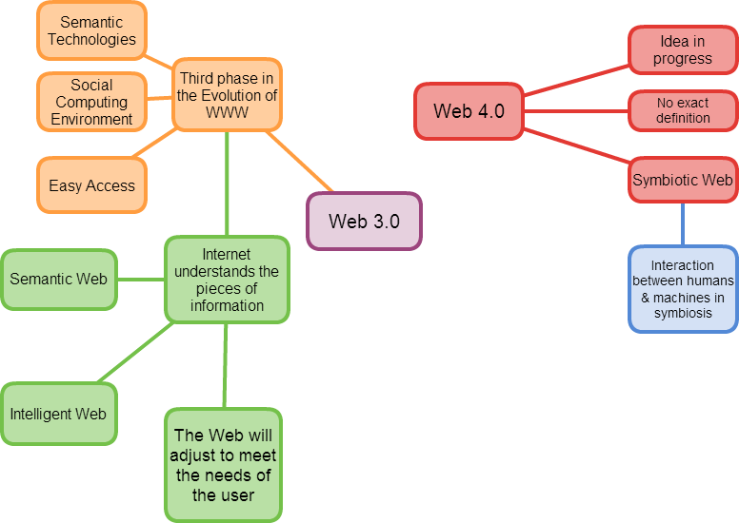

Slide 40
Web 3.0 faces several challenging issue like-
Vastness: The World Wide Web contains many billions of pages. Redundancy in data may occur which has not yet been able to eliminate all semantically duplicated terms.
Vagueness: This arises from the vagueness of user queries, of concepts represented by content providers, of matching query terms to provider terms and of trying to comb
Inconsistency: These are logical contradictions which will inevitably arise during the development of large ontologism and when ontologism from separate sources is combined.
Deceit: This is when the producer of the information is intentionally misleading the consumer of the information.
Compatibility – Web 3.0 has compatibility issues with older version of HTML, Flash etc.
Security – Users data and privacy and its security is also a concern
Logic- Since machines use logic, the AI predicting a users need or certain thing has limitations

